Slide 1
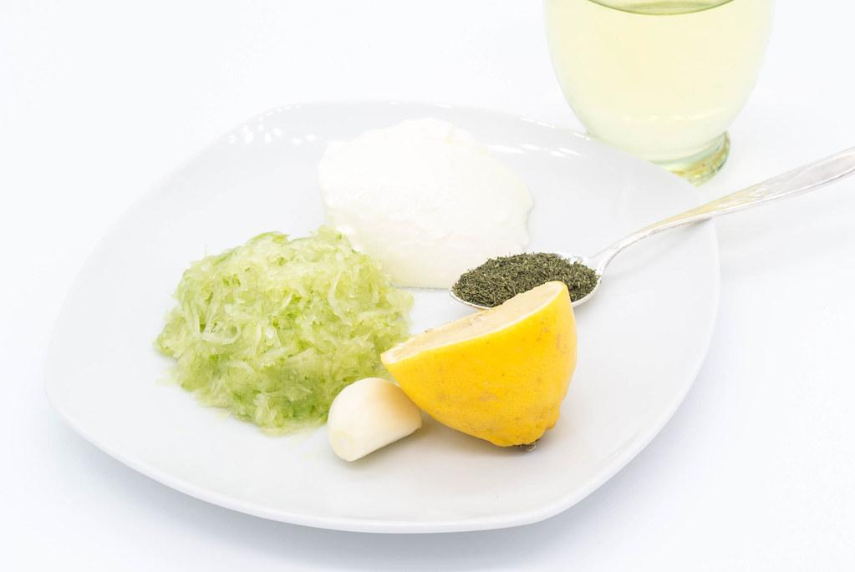
Foogle!
A search engine for food alchemists…!
Deepu Variyangattil
Vishal Reddy P
Malik Mubeen
Neeshit Dangi

Slide 2

Agenda
Problem
Our Solution
High Level Design
Crawling
Extraction
Ranking
User Testing
Demo
Future Enhancements
Questions

Slide 3

Problem Statement..
Search engines are able to direct us to recipe preparation pages if user gives recipe name as search terms.
There’s no easy way to search for recipes based on ingredients.
Search engines usually show wiki pages of ingredients if user searches with ingredients
Search engines also show irrelevant results like Apple Inc if searched with “Apple” keyword.

Slide 4

Our Solution
A search engine where a user can easily access recipe pages
A search engine where a user is able to only get recipe related information
A search engine where a user can get recipes based on ingredients provided
Foogle

Slide 5
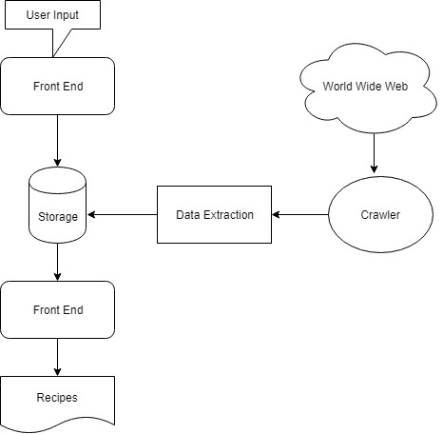
High Level Design

Slide 6
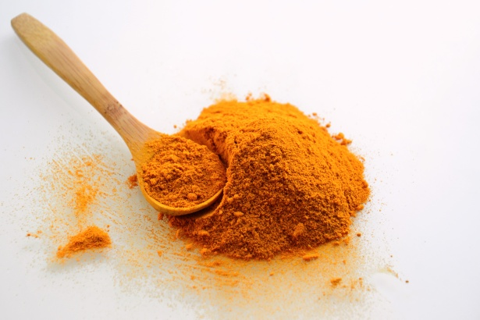
Technologies Used
Python
Selenium
HTML & CSS
JavaScript
Node JS

Slide 7

Source of recipes
We crawled and extracted 12,980 recipes from several popular recipe web sites
Allrecipes.com
FoodNetwork.com
TasteofHome.com
BBCGoodFood.com
Epicurious.com
Delish.com

Slide 8
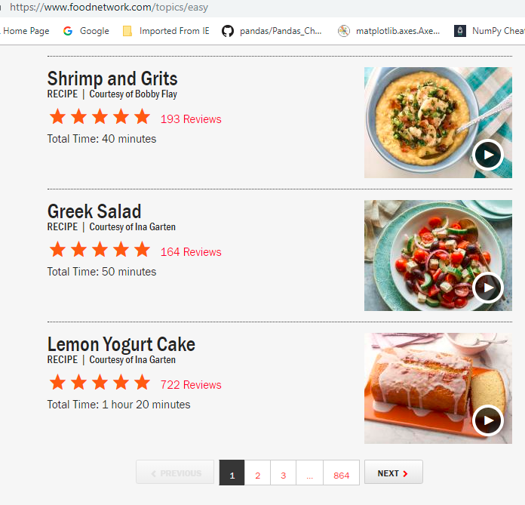
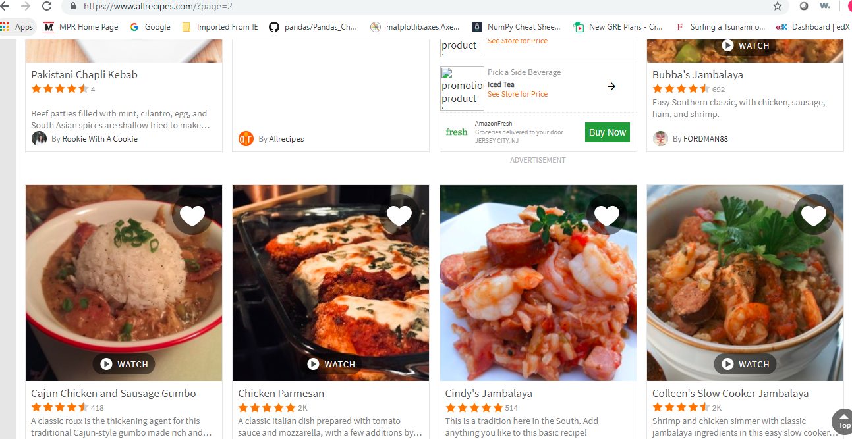
Example of sites

Slide 9
Crawling
Its important to note that each website has a different architecture , Therefore understanding the way the website is organized is crucial.
Using packages like requests, beautiful soup and selenium we were able to identify the target information(ex: URLs, Title, Ingredients, Page Number) from the website’s html page.
After obtaining the URLs we visit each URL and extract the required information into a pandas data frame and later convert it into a csv file.
We have eliminated problems like Timeout Exception and NosuchElement exception(as there could be few trap pages or articles where there would be a different html architecture, This could stop our crawler from scraping data) by using try-catch block

Slide 10
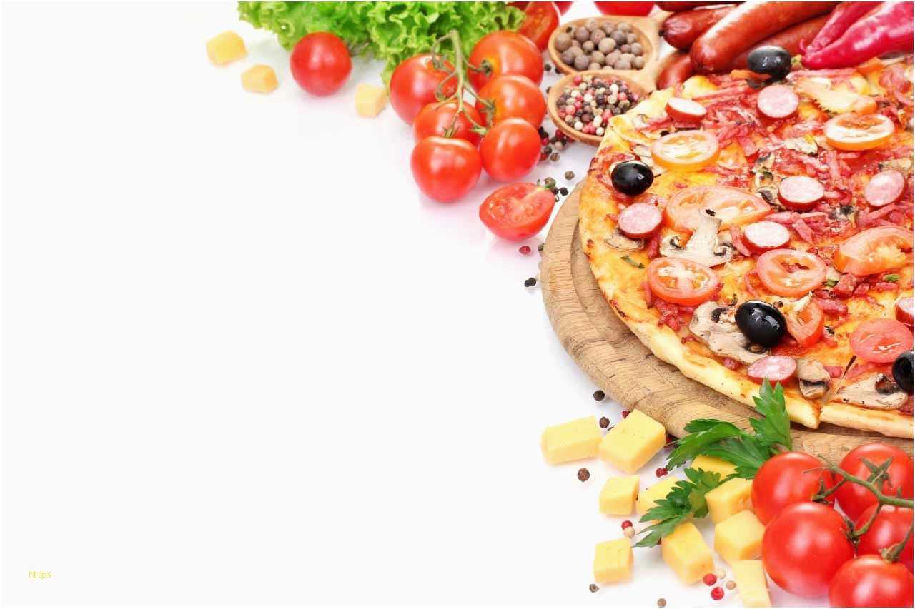
Crawling Policies
Selection Policy:-Breadth First Search
Revist Policy:-Uniform Policy
Politeness Policy:-Robots Exclusion Protocol
Parallelization Policy-None

Slide 11
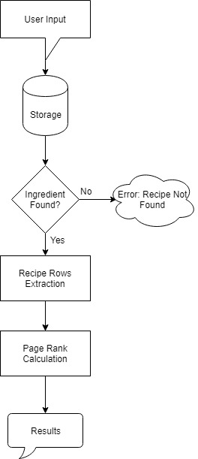
Information Retrival

Slide 12
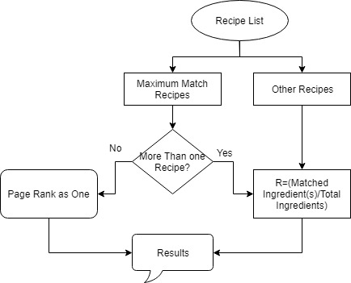
Ranking Results

Slide 13

User Testing
Audience: Students & Home Makers
Initial version has given for testing.
Issues reported were Front End is not attractive and web page objects are not aligned properly
Users suggested to show matched ingredient list as well on the result page
Changed the web page accordingly and has given for re-testing
Finally decided to stick with current design.

Slide 14
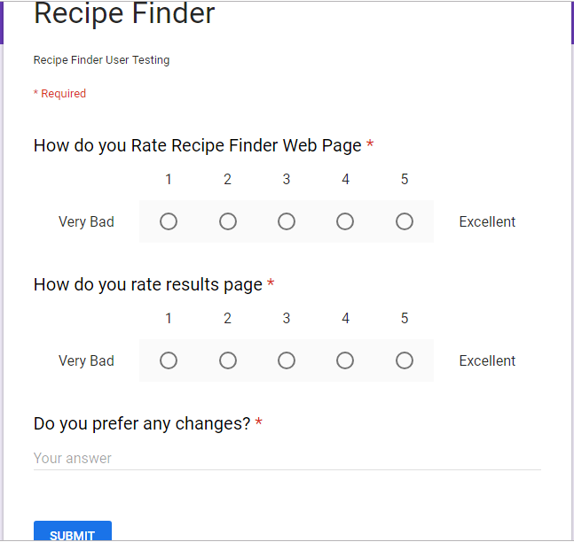
User Testing Web Form

Slide 15

User Testing-Initial Version

Slide 16
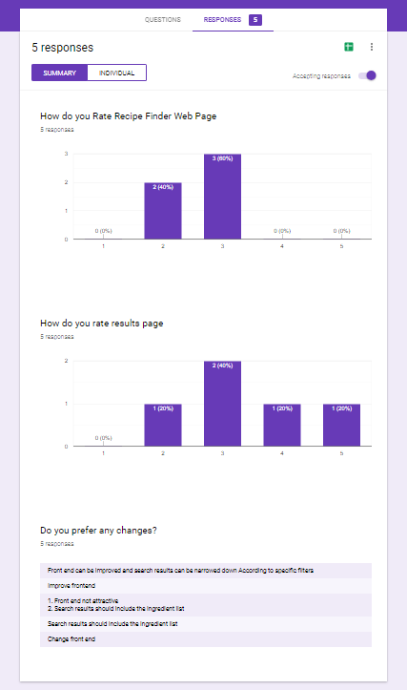
User Testing Responses-Initial

Slide 17
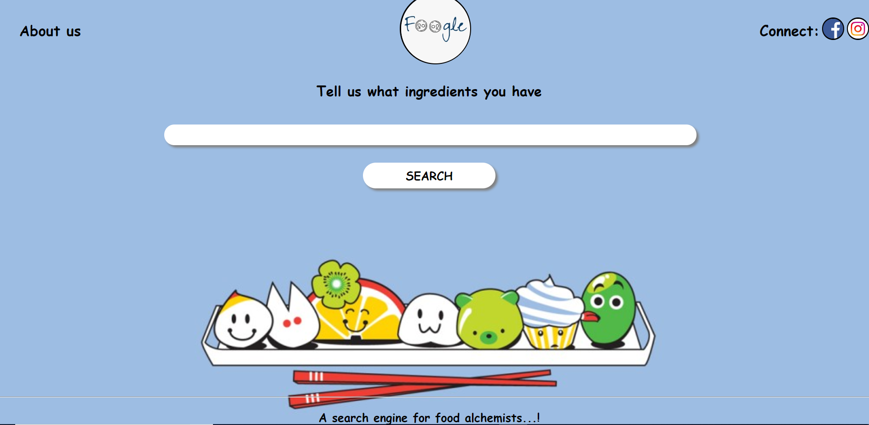
User Testing-Accepted Version

Slide 18
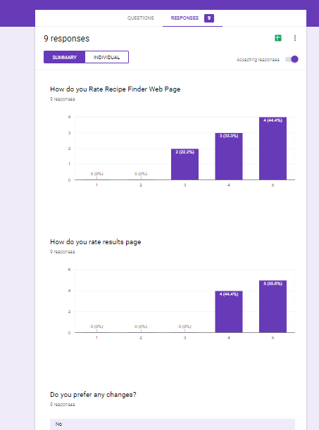
User Testing Responses-Final

Slide 19
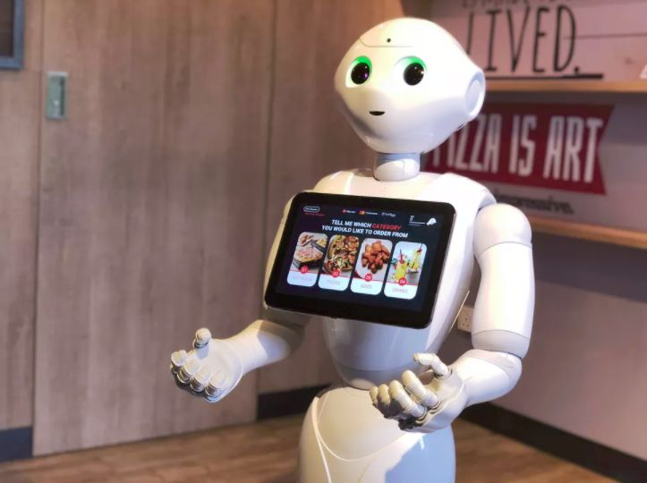
And now… a demo!

Slide 20

Future Enhancements
Tagging important or required ingredients
Additional segmentation or filtering of search results by cuisines and meal type
Deploying the website on public domain
More sophisticated analysis of text inputs
Gathering data from more sources
Visually more responsive or interactive front-end

Slide 21
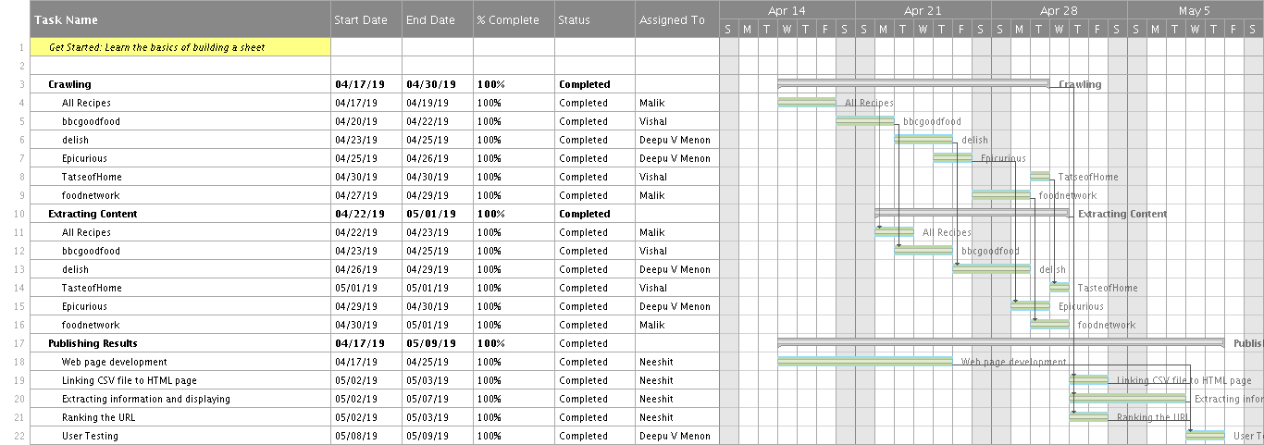
Gantt Chart

Slide 22

References
https://stackoverflow.com/
https://www.seleniumhq.org/
https://www.python.org/download/releases/3.0/
https://www.javascript.com/
https://nodejs.org/en/
https://html.com/

Slide 23


Slide 24


